Slide 1
SAP BTP Extension Suite Training
Day 13
Anubhav Oberoy
www.AnubhavTrainings.com
Follow excellence with sheer passion

Slide 2


DISCLAIMER
The training content and delivery of this presentation is confidential, and cannot be recorded, or copied and distributed to any third party, without the written consent of Anubhav Trainings

Slide 3
Agenda – Day 13
01
Implementing App Router
02
Git and Webhook
03
CI/CD Service in BTP

Slide 4
Challenges in Current Approach
Did you notice, that we need to first pass lots of technical details from service key
Pass all the info in correct manner to postman to obtain token
Once the token expired, we need to reobtain again and again
Our end user do not know all this. Automate the XSUAA JWT token processing.
In our app, we will have multiple microservices, like java, sap ui5, node app, xsuaa…
Each service produce one end point e.g. /vendors, /index.html, /customers, they all logically belongs to same app. Will you give 3 url to our user to access these apps?
These microservices also needs to communicate with each other. Provided we give a single end point to access our entire app to end user.
We want to complete redirect mechanism to let user go to login screen, authenticate on IDP and exchange of all the tokens should be seamless behind the scenes.
We need a single entry point for entire app, forwardAuth tokens should be done automatic.
url
Application router
(Provide single entry point, exchange auth token,
Communicate between microservices, like a facade)
xsuaa
Java
/Anubhav.svc
UI5 App
/index.html
Node
/customer

Slide 5
Introduction to App Router
It is a Node JS Application
It is used to automate the process of authentication, authorization with XSUAA to do token exchange
It sits in the middle of IDP and XSUAA, it will redirect the request to our microservice to xsuaa, and eventually to idp
IDP sends the login screen to the user, user authenticates, which is taken to XSUAA, XSUAA issues JWT Token, this JWT token is presented to api end points
App Router takes the JWT token from XSUAA and gives it to our microservices and even exchange this token to multiple microservices inside
It Serves as a single entry point for the entire app.
To tell app router about our multiple microservices so that it can re-direct, we need to create a configuration file named as xs-app.json which contains the details.

Slide 6



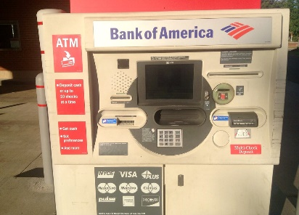
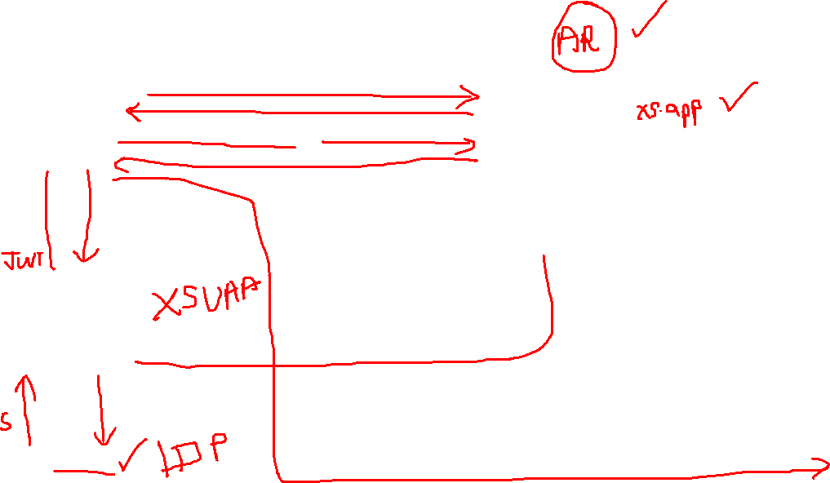
Real World Example
Customer
1
5
4
2
Loan
Credit Card
6
Validate, trust
Deposit
Draft/Cheque
3
FD
*******
7
Locker
This Photo by Unknown Author is licensed under CC BY

Slide 7
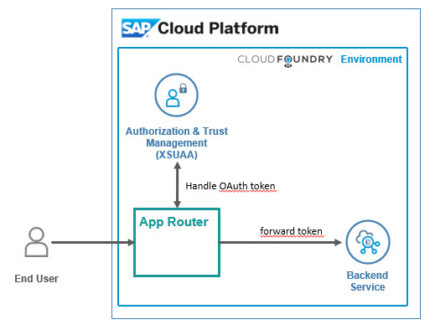
Hands on: App Router
Solution
https://github.com/soyuztechnologies/BTP_Architect_Training/blob/master/Day%203/04approuter.zip

Slide 8
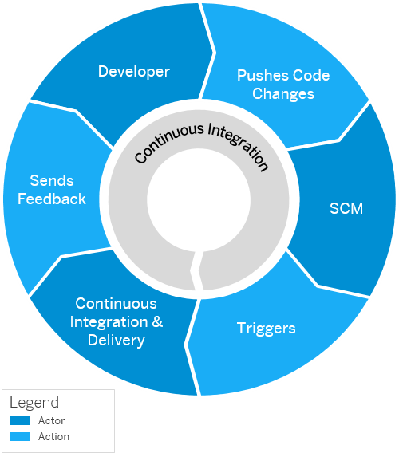
Continuous Integration and Delivery (CI/CD)
Configure and run predefined continuous integration and delivery (CI/CD) pipelines that automatically build, test, and deploy your code changes to speed up your development and delivery cycles.
Continuous integration (CI) describes a software development process, in which various team members integrate their contributions frequently into a single main line. Before each integration, the changes are verified through builds and automated testing. Thereby, you can detect errors as quickly as possible and prevent integration problems before completing the development.
The continuous delivery (CD) concept expands on the one of continuous integration. It adds the aspect that any change that has successfully passed the tests is immediately ready to be deployed to production, both from a technical and a qualitative point of view.

Slide 9
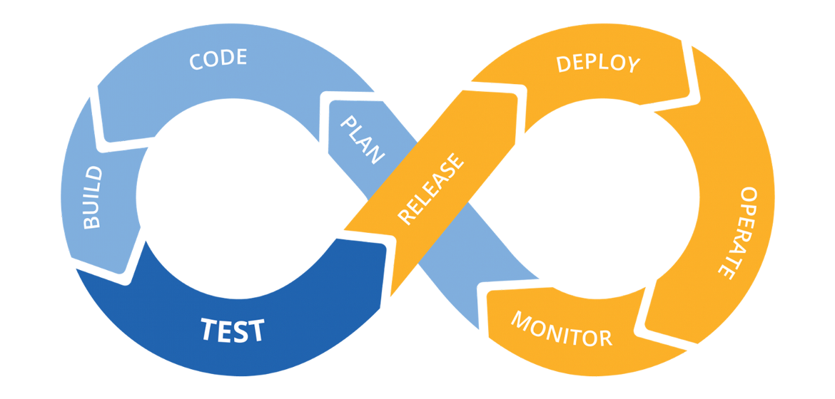
Hands on: Continuous Integration

Slide 10
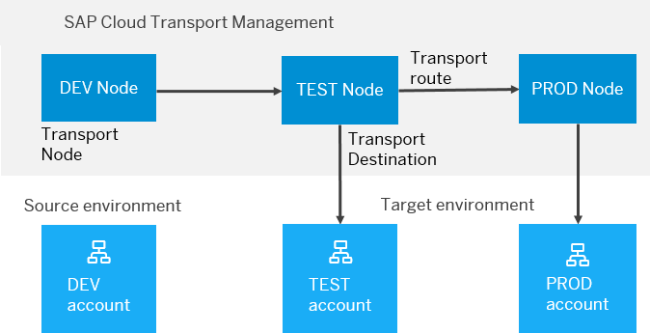
BTP Cloud Transport Management
SAP Cloud Transport Management service lets you manage software deliverables between accounts of different environments (such as Neo and Cloud Foundry), by transporting them across various runtimes. This includes application artifacts as well as their respective application-specific content.
SAP Cloud Transport Management service adds transparency to the audit trail of changes so that you get information about who performed which changes in your production environment, and when they did it. At the same time, the service enables a separation of concerns: For example, a developer of an application or of SAP Cloud content artifacts can trigger the transport of changes in a development subaccount, while the resulting import into the test, and production subaccount is handled by a central operations team.

Slide 11
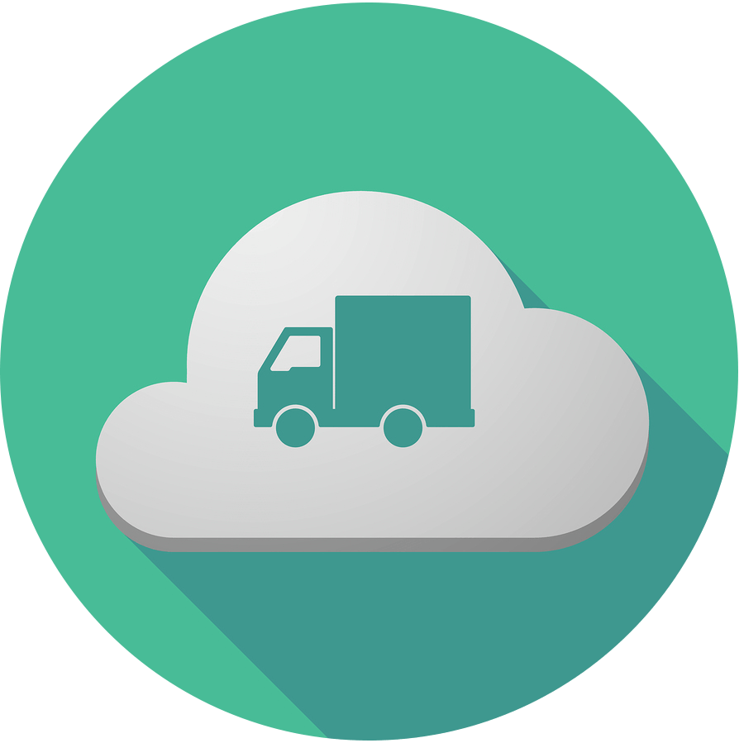
Hands on SAP BTP Cloud Transport

Slide 12

What We Did
Let’s Summarize

Slide 13

www.anubhavtrainings.com
Thank You
End of Day 6

Slide 14


We’re committed to empower you to be
#FutureReady
through powerful training solutions.
We build the workforce of the future.
260+
Corporate Clients
60,000+
Learners Trained
26000+
Learners Placed
FREE WEBINARS
Sign up for free webinars with industry experts every fortnight!
Enroll Now!
Contact us today!
https://anubhavtrainings.com

